Slide 2
Lake Haven Stream Restoration Project
The Owner:
Gwinnett County Dept. of Water Resources Lawrenceville, Georgia Project Engineer
Mr. Pete Wright, PE
The Contractor:
The Dickerson Group, Inc. Lawrenceville, Georgia Mr. Jason Freeland, Site and Project Foreman
2008

Slide 4
The Landscape before The Dickerson Group started the Project

Slide 6
Broken and hazardous weir structure, allowing for little to no drainage for Storm Water runoff.

Slide 9
Stagnate water, excessive erosion and the undergrowth, were not a very attractive view from this homeowners back deck.

Slide 12
The Transformation Begins
CAUTION
WORKERS
AHEAD

Slide 13
The Construction Entrance

Slide 14
The Staging Area, for River Stone Materials

Slide 17
The Main Pond is excavated and the surrounding areas are cleaned of debris

Slide 24
With artisans hands, these large boulders were embedded into the banks, and the grass matting was carefully tucked and secured to the bank walls. River stone was used as the bedding for the pools of each vane.

Slide 26
Areas of stagnate water, and restricted flow have been eliminated
With many of the rock vanes in and the pools set up, the Landscape takes new shape, and the natural beauty of the area comes to life.

Slide 28
The New Retaining Wall is being constructed

Slide 30
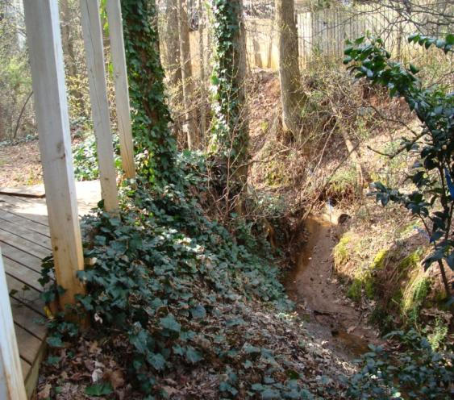
BEFORE

Slide 35
Fallen and dead tree trunks were used between the pools to enhance the flow and the natural look of the stream

Slide 36
New Rock Structures were built and added to the existing Headwalls

Slide 38
The lower section is now complete and a whole new landscape has developed

Slide 44
Now we have the task of reworking the main pond and the washed away ditch, that was the drainage path for the storm water coming from adjacent streets. On the right side of the next slide you will see where the ditch was reformed.
Storm water pipe was laid in and then covered and leveled. There is no sign that erosion ever took place in this area. The new grass is already taking root and growing.

Slide 45
Pre-existing Headwall
Newly installed Storm Pipe

Slide 46
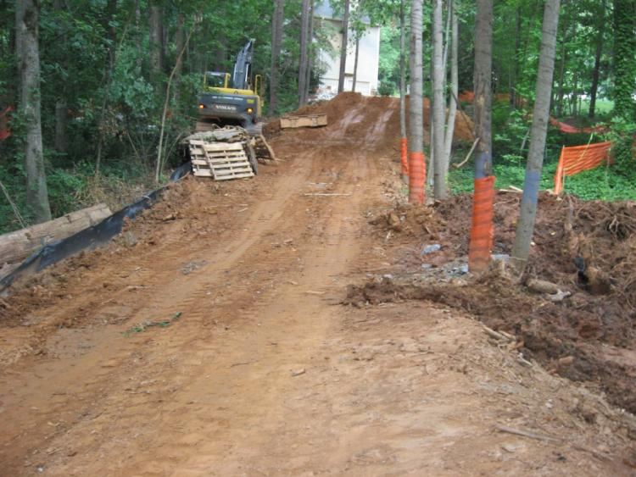
BEFORE

Slide 47
ALL of the Rock Structures you see ,and have seen, throughout this presentation, were HAND MADE by Mr. Freeland and his Crew

Slide 52
All of the major changes have been implemented and the finishing touches are all that remain to be completed. We will then let nature take care of this new beginning for the area.
The residents of this neighborhood now have an area that resembles a PARK instead of a hazardous eyesore.

Slide 53
The view from the Weir Structure showing the lower section of the project.

Slide 55
The stone work here was designed to reduce the velocity of the storm water coming from the street

Slide 62
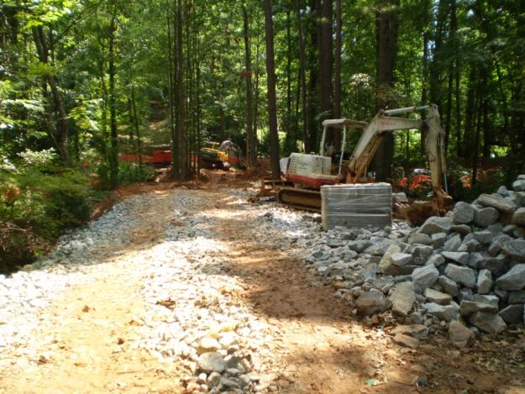
BEFORE
Construction Entrance

Slide 63
The Construction Entrance is completed and the new driveway is formed for replacement.

Slide 67
The new Driveway is completed

Slide 68
The Project is Completed
The following four , are short movies of the Storm Water flowing through its new paths during a recent rain shower, on October 8th, 2008.
We at DGI hope that you enjoyed our presentation of this project.

Slide 73
CREDITS
The Contractor: The Dickerson Group, Inc. Billy Joe Dickerson, Owner, President, CEO 871 Old Peachtree Road, NW Lawrenceville, GA 30043 Phone: 770-513-4558 Fax: 770-513-4740
The Crew: Jason Freeland, Site and Project Foreman Turrom Mayweather Branden Blanchard William Paradis Jose Guevara Steven Newton Willie Fleming Dennis Evans Roger Peters
Photographs Taken BY : Before: Pete Wright,PE Gwinnett County Water Resources Progressive: Ben Presley, The Dickerson Group, Inc. Progressive : Robert Brush, The Dickerson Group, Inc.
Slideshow Produced by: Robert Brush, The Dickerson Group, Inc.
All rights reserved, no reproduction, or duplication permitted without the express written Permission of The Dickerson Group, Inc.

Slide 74
END

